Slide 1
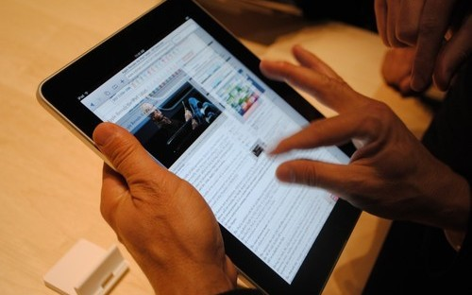
Classroom Management and Digital Citizenship
Lynn Hagen
Battle High School
lhagen@cpsk12.org
@lynnahagen
Allthingsliterate.weebly.com
With 1:1 iPads

Slide 2
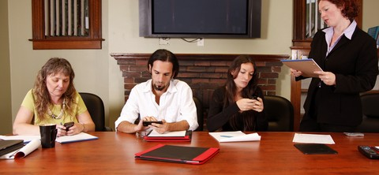
Starting with OURSELVES
What is your personal culture with your device?

Slide 3
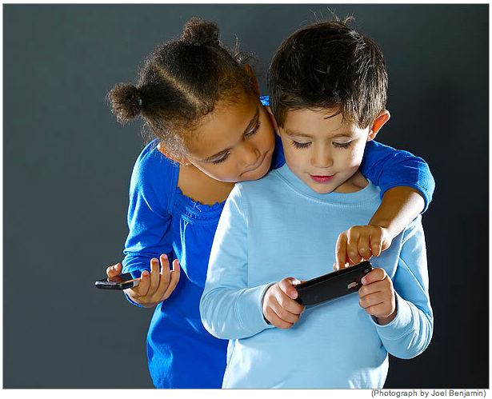
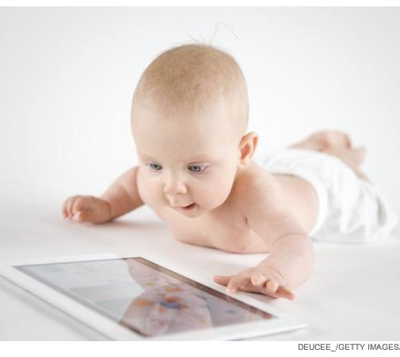
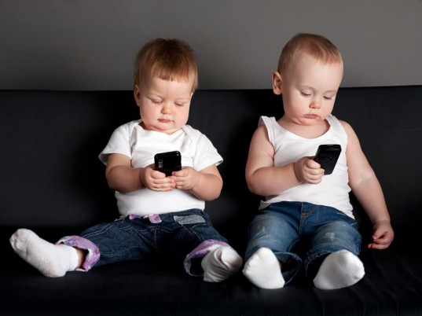
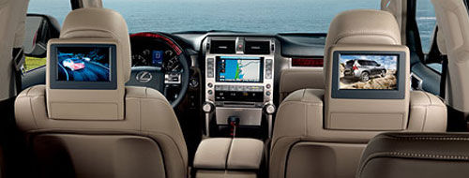
And our KIDS?
“Just because they’re “natives” doesn’t mean they get it.”

Slide 4
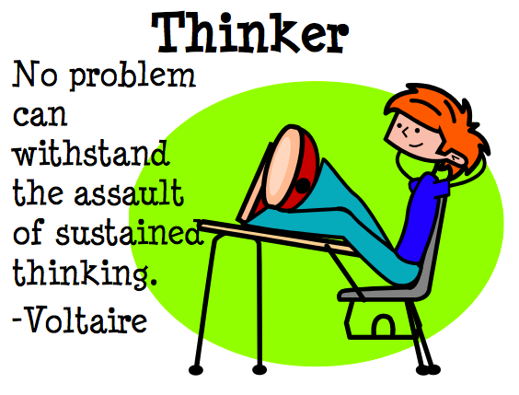
CREATE classroom culture with 7 Keys…
Hint: Store classroom procedures as pictures on their iPads
Be proactive!
Create expectations
Work with colleagues to create common procedures
Work with administration & media specialists to clarify expectations school-wide

Slide 5
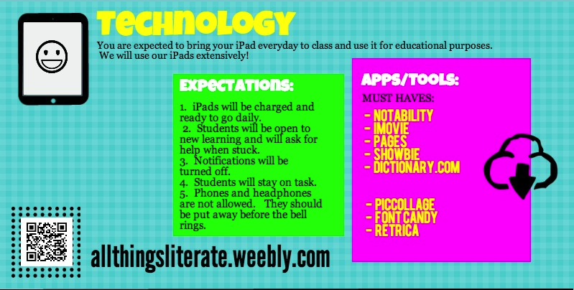
Communicate with kids & parents:

Slide 6
2. Know your audience
KIDS:
social/emotional/developmental stage?
As learners – strengths and needs
Individually – who are they?
PARENTS:
Support? Expectations? Fears?
Make NO ASSUMPTIONS!

Slide 7
3. Build a Community
Just like you build connections with your kids WITHOUT technology; you build one WITH it too.
Create REAL AUDIENCES
Kristin Ziemke and Katie Muhtaris: https://innovateigniteinspire.wordpress.com/

Slide 8
4. Teach, not tell
There is no silver bullet, no bulletin board, no one-lesson magic!
WEAVE in technology procedures/how to over time & into lessons
Plan on 2-3 months to establish independence with practices/procedures

Slide 9
5. Have a PURPOSE
How YOU introduce and let your kids use the iPad will set the tone for the YEAR (and longer!!)
The iPad is out on a desk…WHY?
The iPad is going home…WHY?
Best practice FIRST.
Then, how can technology amplify best practice?
You MUST have a purpose for the device at all times, or it is PUT AWAY.

Slide 10
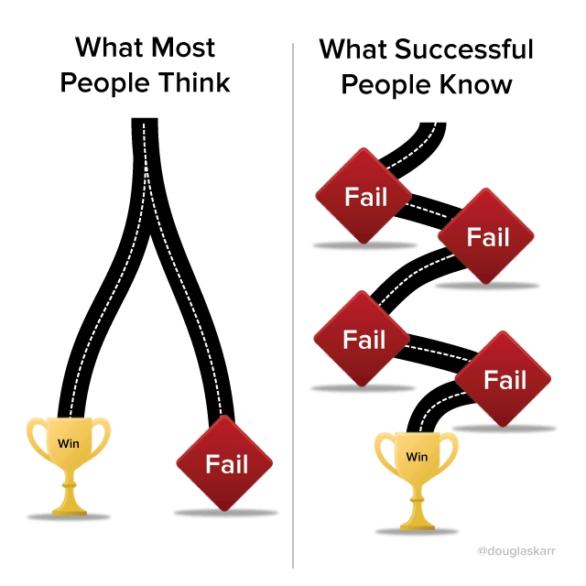
6. Be a learner
Chief learner, wonderer and “failer”
Model solving problems/trouble shooting – kids feel safe when they see you take risks and handle failure
Model each step (Air Server)
Partner with your kids
Let kids contribute and help you
YOUR ATTITUDE SETS THE CLIMATE!

Slide 11
7. Have a sense of adventure and fun
I don’t mean letting your kids PLAY random things!
How can I give my students an authentic voice and ownership over their learning?
How can we make this project more engaging with technology?
How can we create something we’re proud to share?
How can we show that the challenges of learning are FUN?

